Slide 1
Urban Rabies ABM- Draft Figures

Slide 2
Questions
Can rabies be eliminated from urban landscapes at seroprevalence rates less than 60%?
Which management/ecological factors influence probability of rabies elimination and re-invasion?

Slide 3
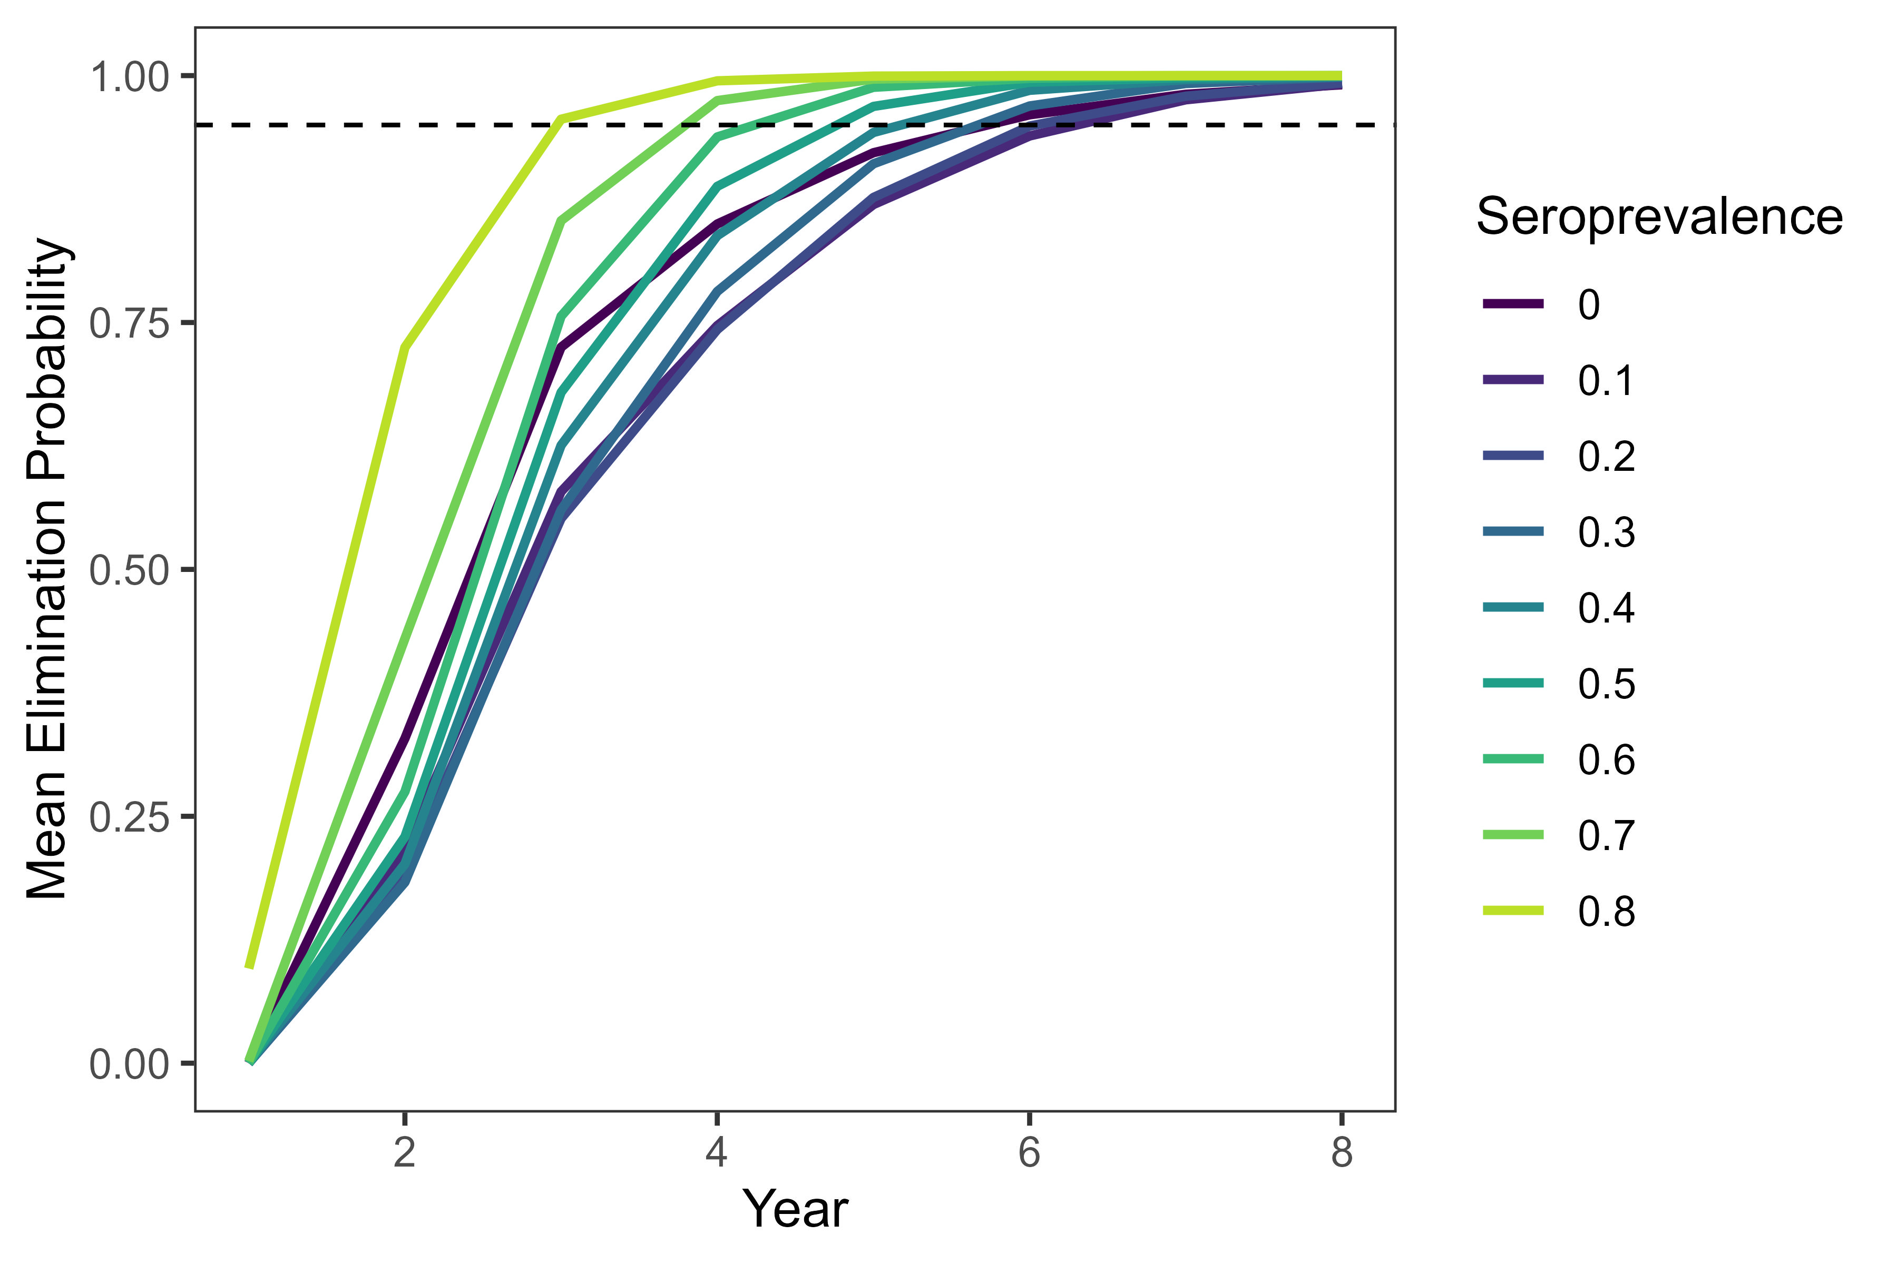
Rabies is usually eliminated in 10 year period, regardless of seroprevalence

Slide 4
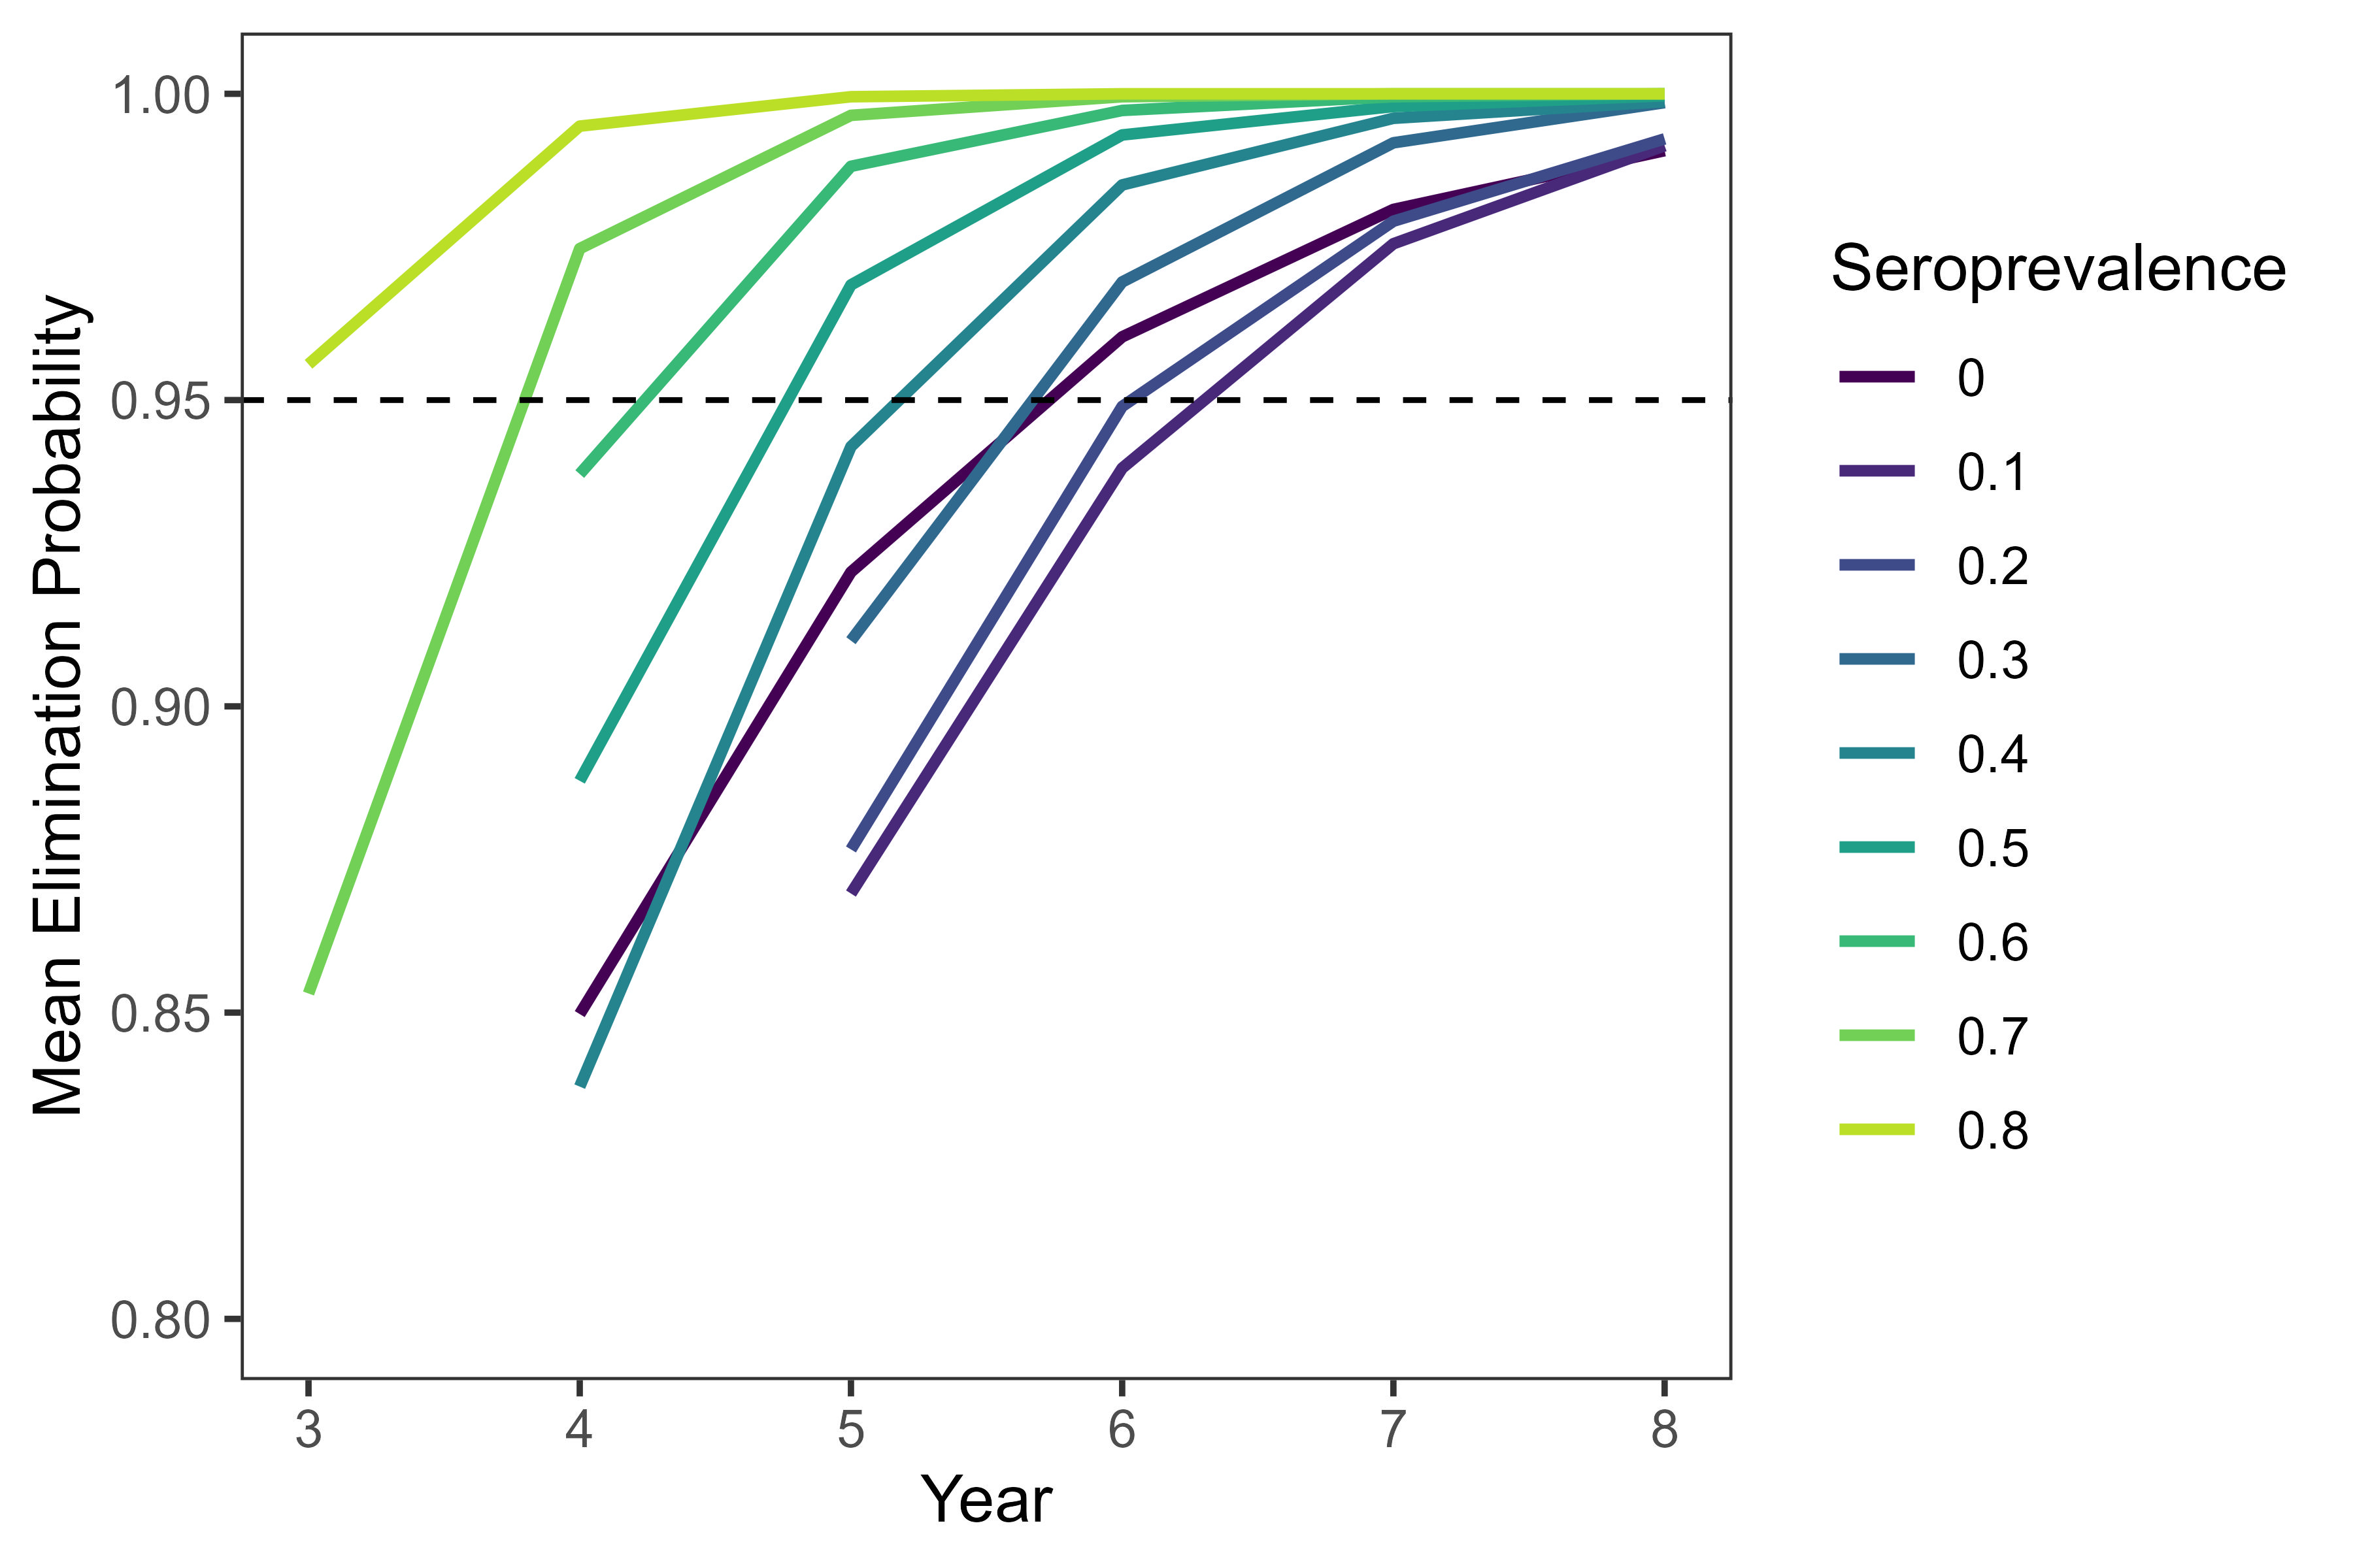
10-30% seroprevalence lengthens time to elimination

Slide 5
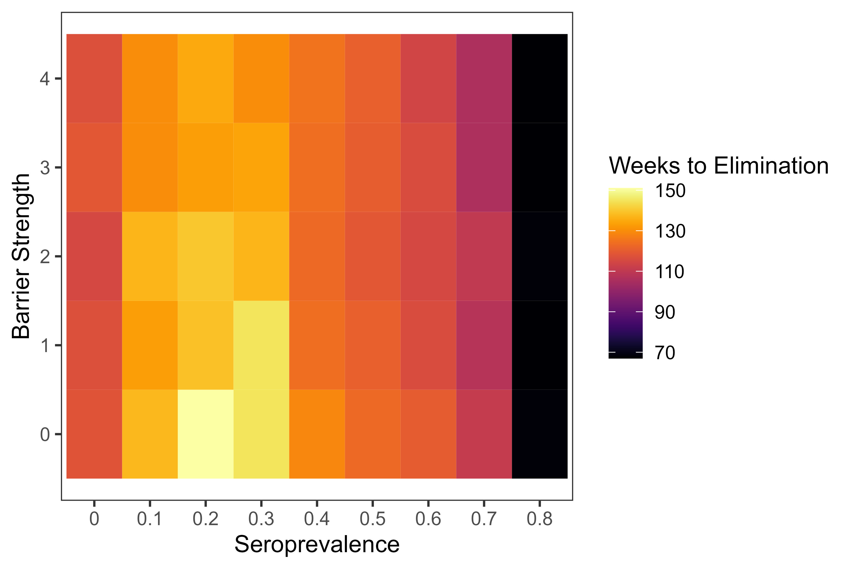
Landscape barriers have small effect at low seroprevalence rates

Slide 6
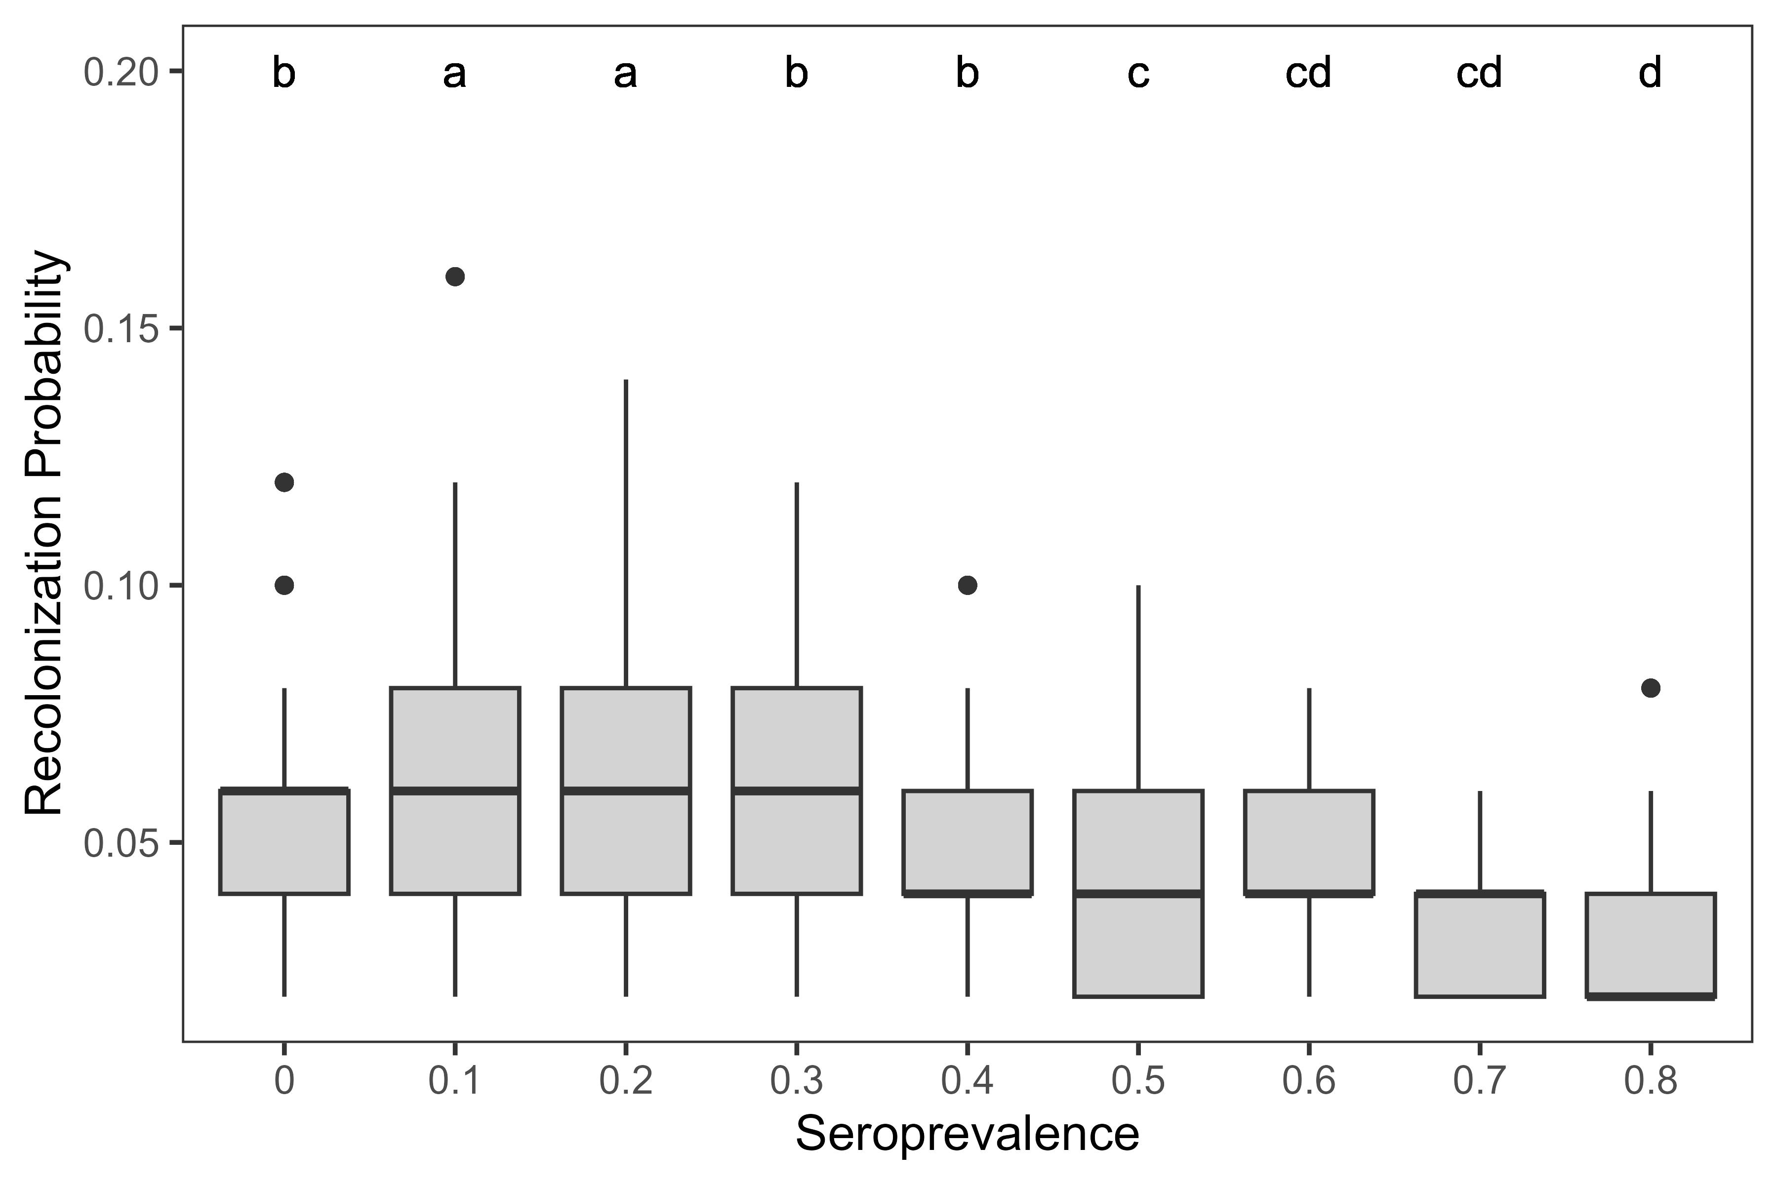
Prob of reinvasion generally low, start to see improvement at 50% seroprevalence

Slide 7
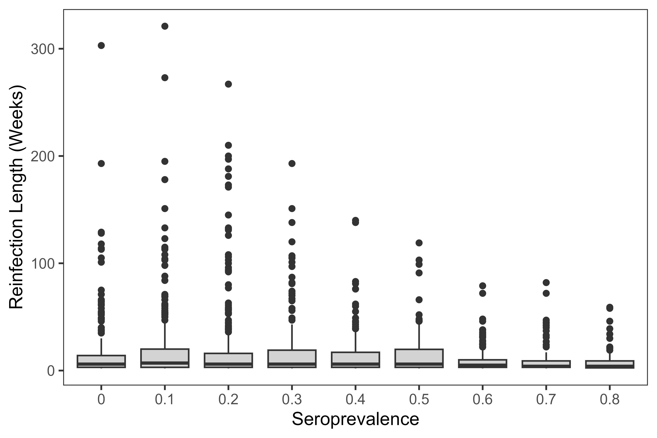
Lower sero values lead to longer reinfection periods

Slide 8
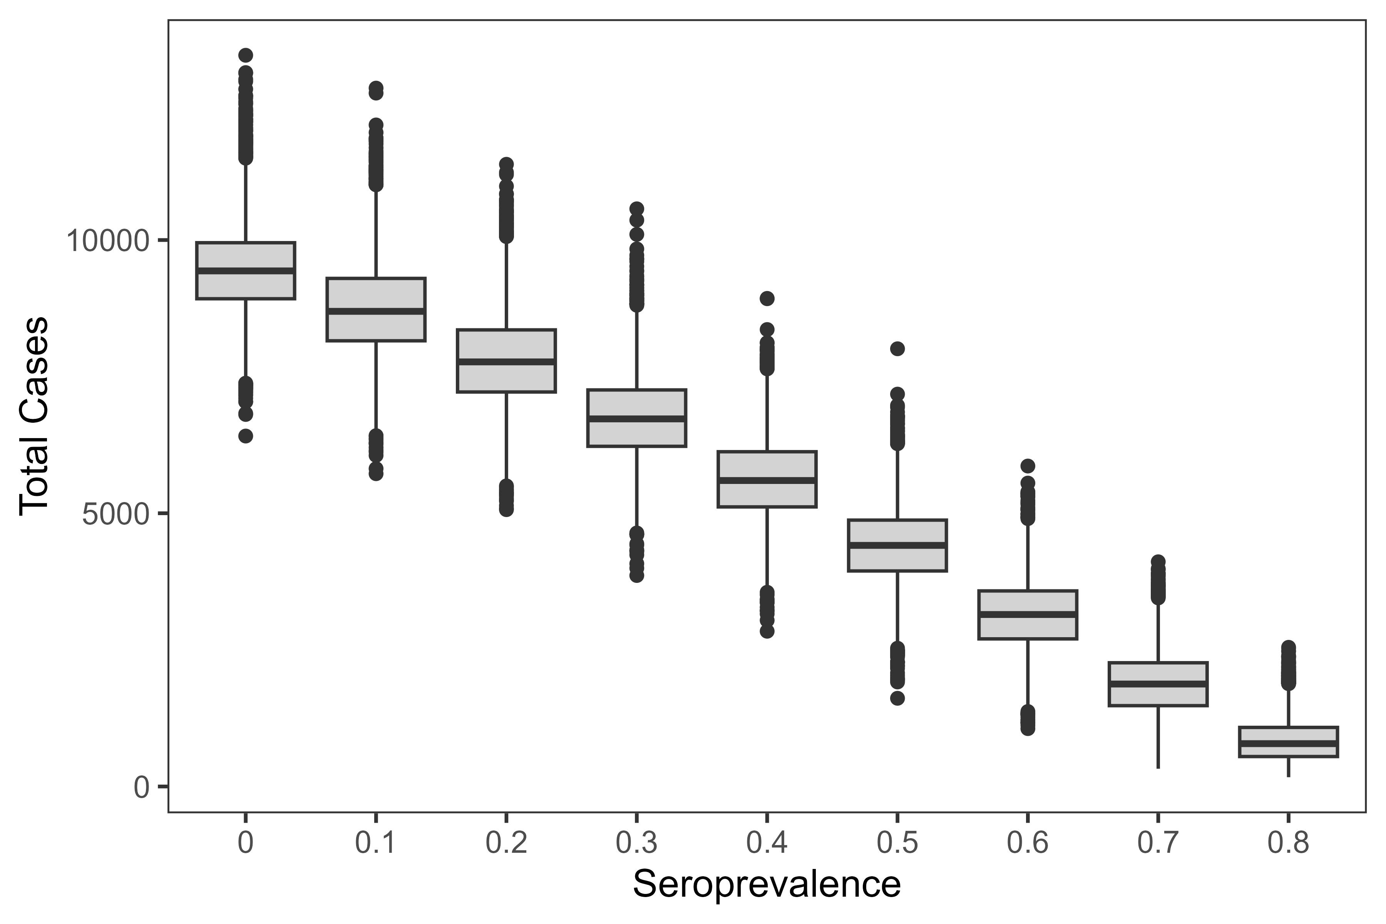
Every increase in seroprevalence = reduction in cases (and overall prevalence)

Slide 9
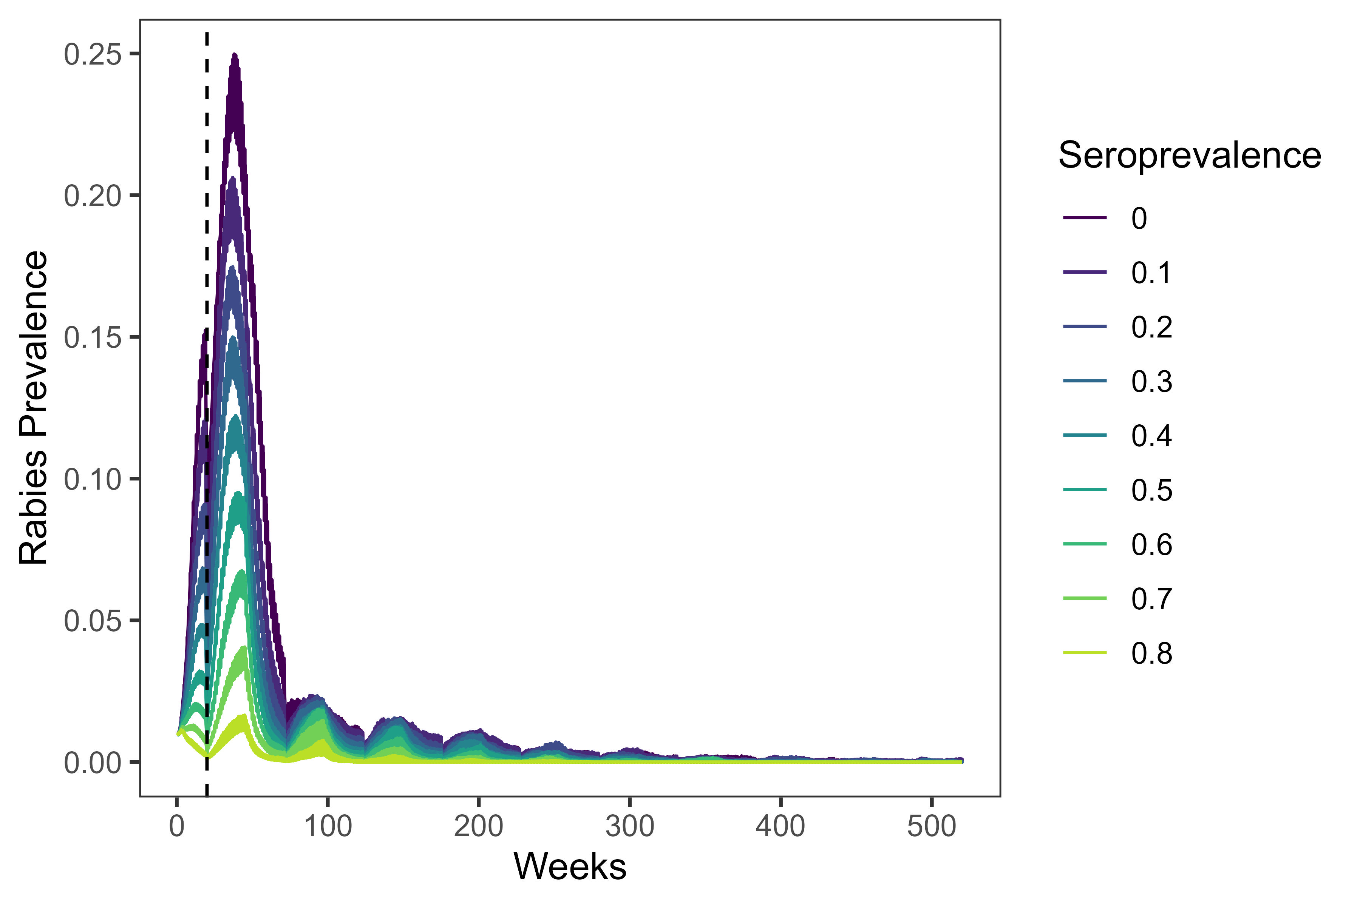
Prevalence and n cases drop after huge initial spike

Slide 10
Birth pulses also lead to a spike in cases/prevalence

Slide 11
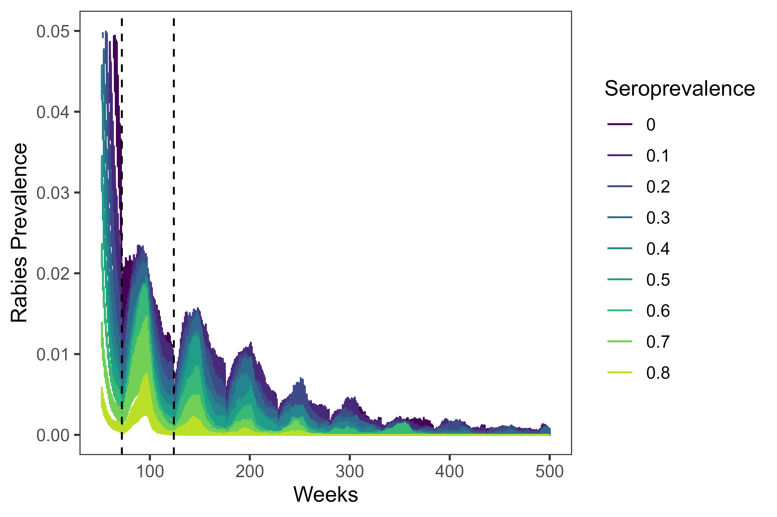
Birth pulses (dashed) lead to additional pulses after initial spike

Slide 12
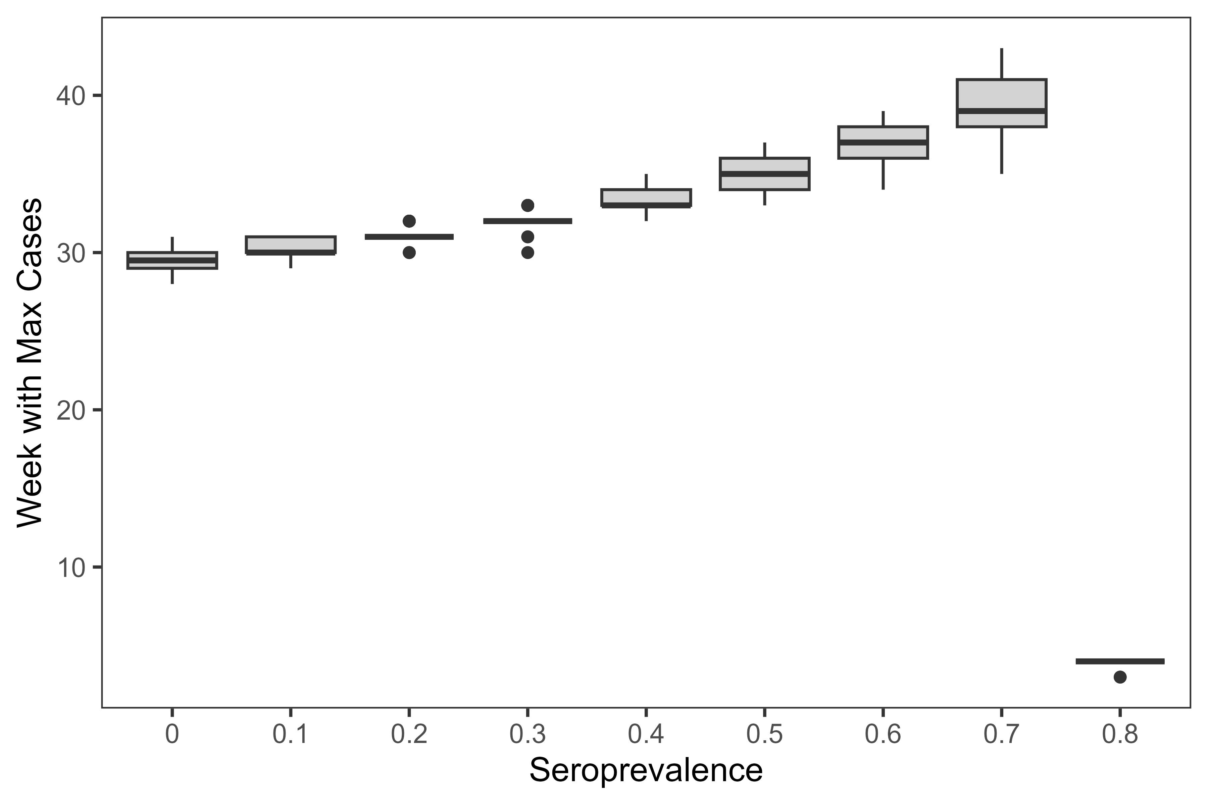
Timing of case spikes varies with seroprevalence

Slide 13
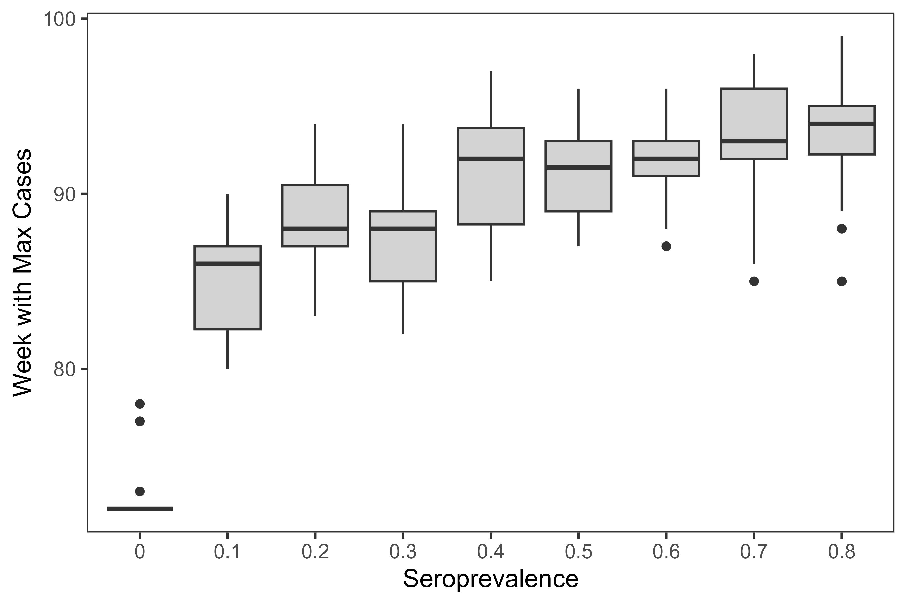
Timing of case spikes varies with seroprevalence (2nd spike)

Slide 14
Conclusions
Rabies was eliminated in all but 1 replicate
50% seroprevalence or higher reduces time to first infection & probability of reinvasion

Slide 15
Conclusions
Seroprevalence of 10-30% leads to longer time to elimination, greater chance of reinfection than doing nothing
Why? Because with 0% seroprevalence, almost everyone dies. 10-30% leaves more survivors for the next birth pulse

Slide 16
Conclusions
Any increase in seroprevalence leads to case reductions
Birth pulses matter quite a bit
Management recommendations?
Seasonality of the bait drop to vaccinate juveniles probably matters a lot
Target seroprevalence depends on goals and resources available- based on these results, 60% seems a bit arbitrary

